Slide 1
第五节课：社会模拟

Slide 2
代理人基模型(agent based model)
社会模拟里最常见的模型
回顾第一周：
“计算”社会科学曾经指的是用计算机进行的社会模拟
1971年，诺贝尔奖得主Thomas Schelling 创造了一个很简单的代理人基模型（Agent Based Model)来模拟美国社会的种族隔离
http://nifty.stanford.edu/2014/mccown-schelling-model-segregation/

Slide 3
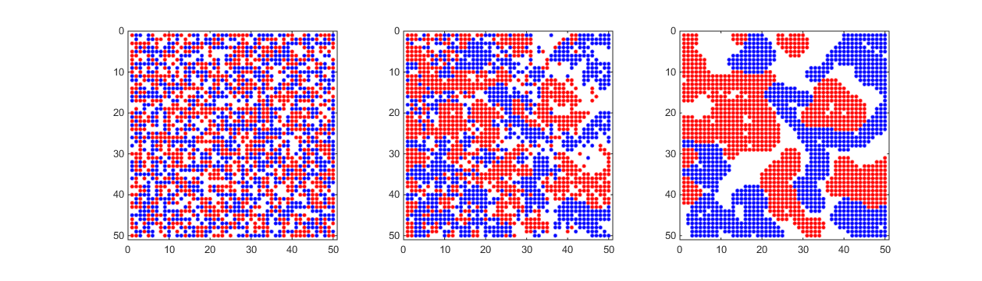
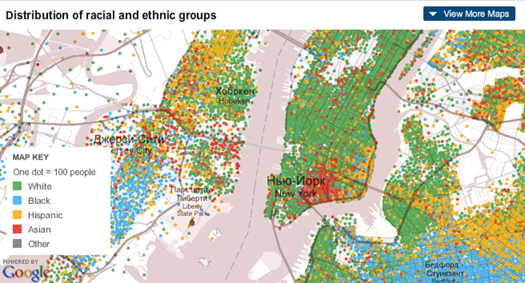
实际的种族隔离
简单的一个模型

Slide 4
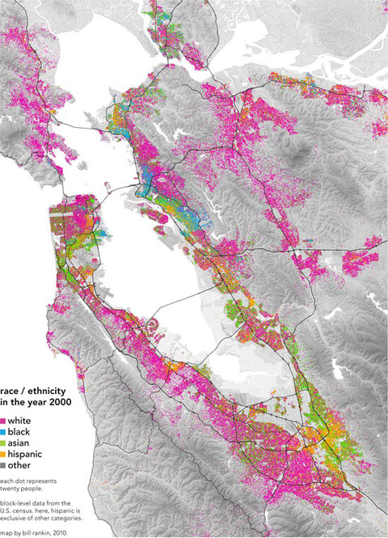
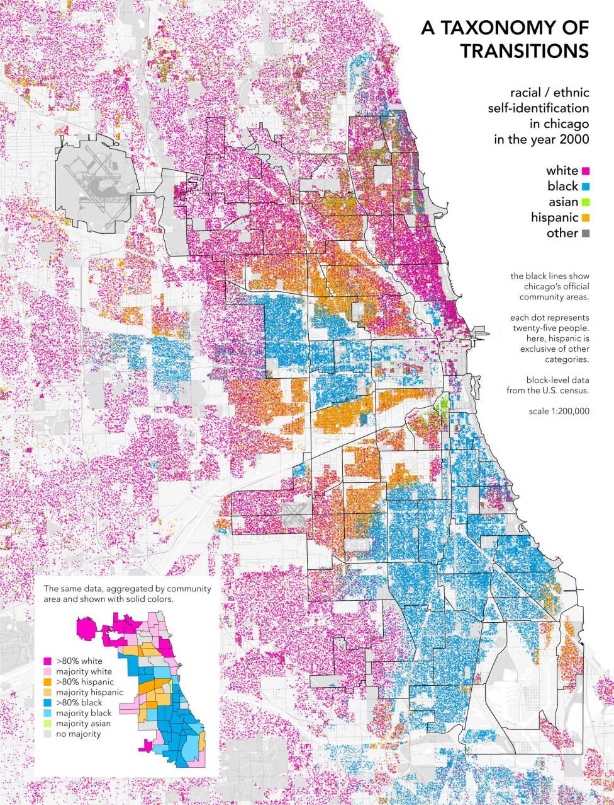
湾区
芝加哥

Slide 5
Agent based model的课
https://www.complexityexplorer.org/courses/90-introduction-to-agent-based-modeling/segments/6952
https://www.complexityexplorer.org/courses/90-introduction-to-agent-based-modeling-2018/segments/6954
https://www.complexityexplorer.org/courses/90-introduction-to-agent-based-modeling-2018/segments/6955

Slide 6
Emperor’s Dillemma
https://www.youtube.com/watch?v=3nfbtrnuqDM&list=PLa6nngtYVzYFQzz3BJtjmXZwe4YoYrq4T&index=2

Slide 8
ABM模型的核心假设：无法预测
One of the reasons why I argued that machine learning has not caught on within sociology as much as other disciplines is that it is fundamentally about making predictions. Agent-based models, by contrast, assume that prediction is inherently impossible because most social systems are complex and adapative or “stochastic.”“ Instead of predicting an outcome, we therefore use ABMs to simulate many different possible outcomes, and use these simulations to both A) develop better theories; and B) create better ways of testing them.
我们用ABM去模拟很多不同的可能结果，然后用这些模拟去发展更好的理论和创造更好的方法去测试这些理论

Slide 9
Michael Macy
Macy, M. W., & Willer, R. (2002). From factors to actors: Computational sociology and agent-based modeling. Annual review of sociology, 28(1), 143-166.
Centola, D., Willer, R., & Macy, M. (2005). The emperor’s dilemma: A computational model of self-enforcing norms. American Journal of Sociology, 110(4), 1009-1040.
Flache, A., & Macy, M. W. (2011). Small worlds and cultural polarization. The Journal of Mathematical Sociology, 35(1-3), 146-176.
Macy, M., Deri, S., Ruch, A., & Tong, N. (2019). Opinion cascades and the unpredictability of partisan polarization. Science advances, 5(8), eaax0754.

Slide 10
小世界和文化两极化 Small worlds and cultural polarization
we find that ties between clusters facilitate cultural convergence under the
micro-level assumptions of assimilation and attraction to similar others. However, these assumptions also have negative counterparts—differentiation and xenophobia.
We found that when these negative possibilities are no longer assumed
away, the effect of long-range ties reverses: Even very small amounts of contact
between highly clustered communities sharply increased polarization at the population
level.

Slide 11
两个控制因素
1. 宏观上，我们控制网络结构：网络中长距离链接的比例（structural assumptions about the proportion of long-range ties in the access network. ）
2. 微观上，我们控制互相影响的方向：互相同化和互相排斥（microlevel assumptions about positive and negative valence of interaction）。此外，我们还有一个额外的roboutness check: 改变“文化维度”/“有争议的议题数量”/ “文化复杂性”

Slide 12
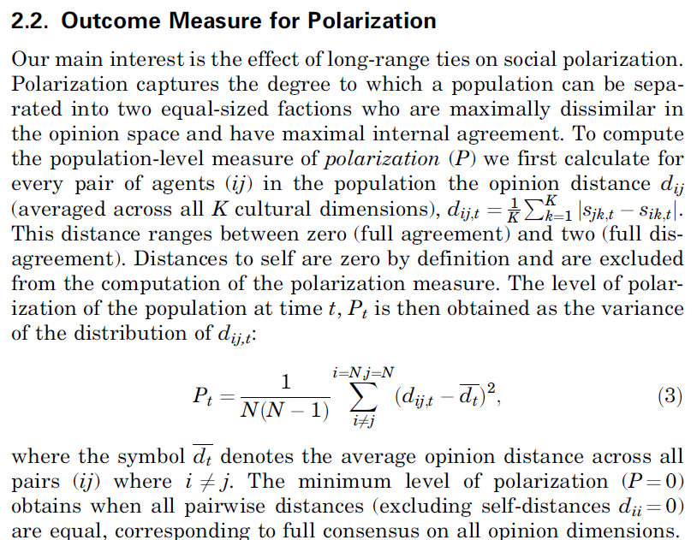
测量：全人口的政治两极化程度P：

Slide 13
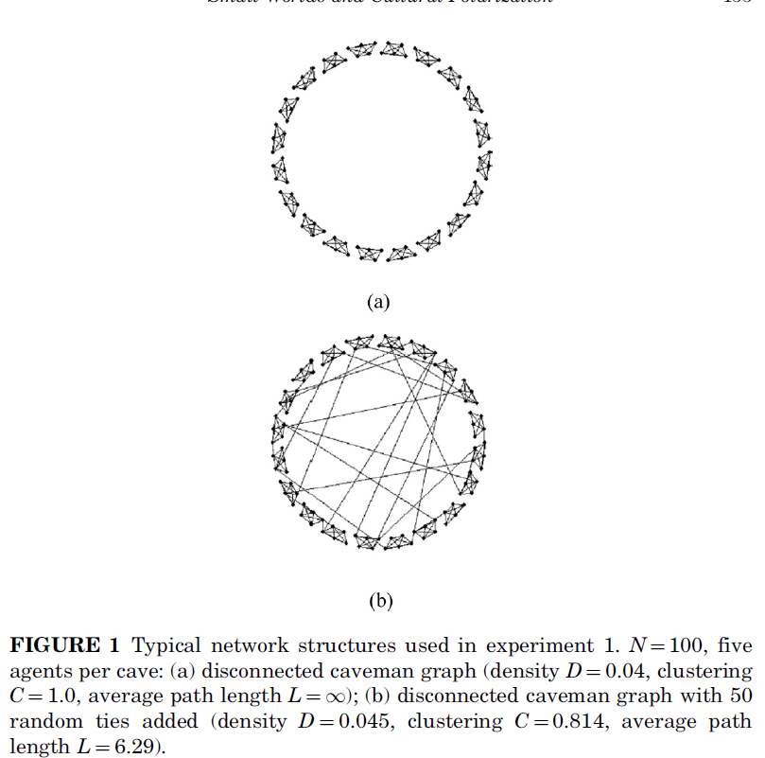
建模：经典小世界

Slide 14
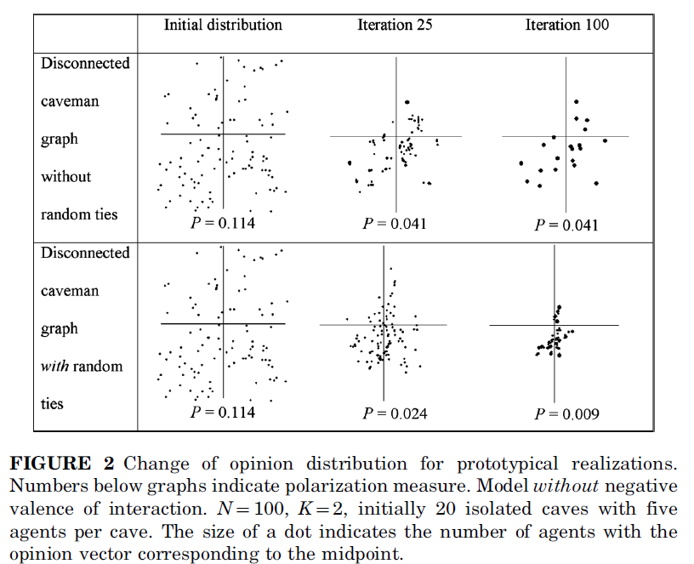
假设交流中只存在同化：交流只有正面的，能减少两极化
坐标：两个议题。距离代表这个议题上的观点/价值观的差距

Slide 15
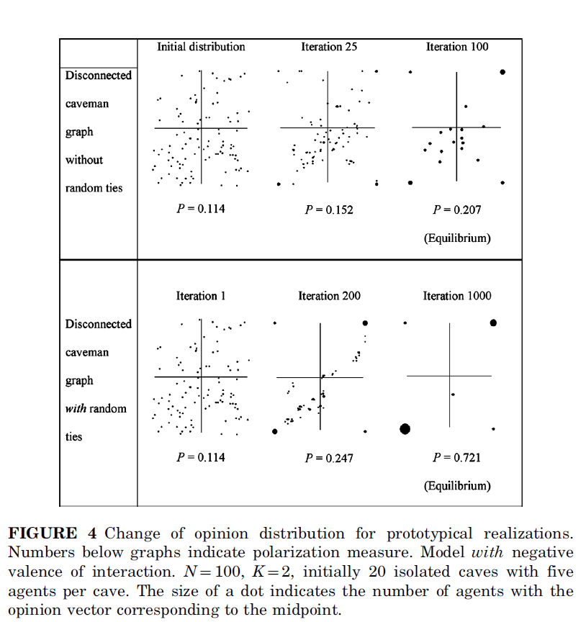
假设交流中同时存在同化和敌对：交流显著增加两极化

Slide 16
Opinion dynamics shown in Figure 4 are characterized by both
assimilation and differentiation. Without random ties, most agents
have by iteration 25 moved toward the midpoint of the opinion distribution
in their cave, but in some caves agents also increase their distance
to others and shift toward extreme opinions. The self-reinforcing
dynamics of polarization are constrained by the boundaries of the
caves. By iteration 100, a local consensus has established in 14 of
the 20 caves. In those caves, all agents adopt ‘‘moderate’’ opinions,
close to the midpoint of the opinion scale. However, in six caves, all
agents have adopted extreme positions on both dimensions. The prevalence
of local consensus is due to the fact that initially weights are
more likely to be positive than negative, such that there is more
assimilation than differentiation within ties. In those caves that did
polarize, initial opinion differences created relatively more negative
ties by random chance. To differentiate from their ‘‘enemies,’’ agents
shift their opinions toward the extreme opposite end of the spectrum,
pulling their friends with them, and turning positive ties into hostile
relationships in the process.

Slide 17
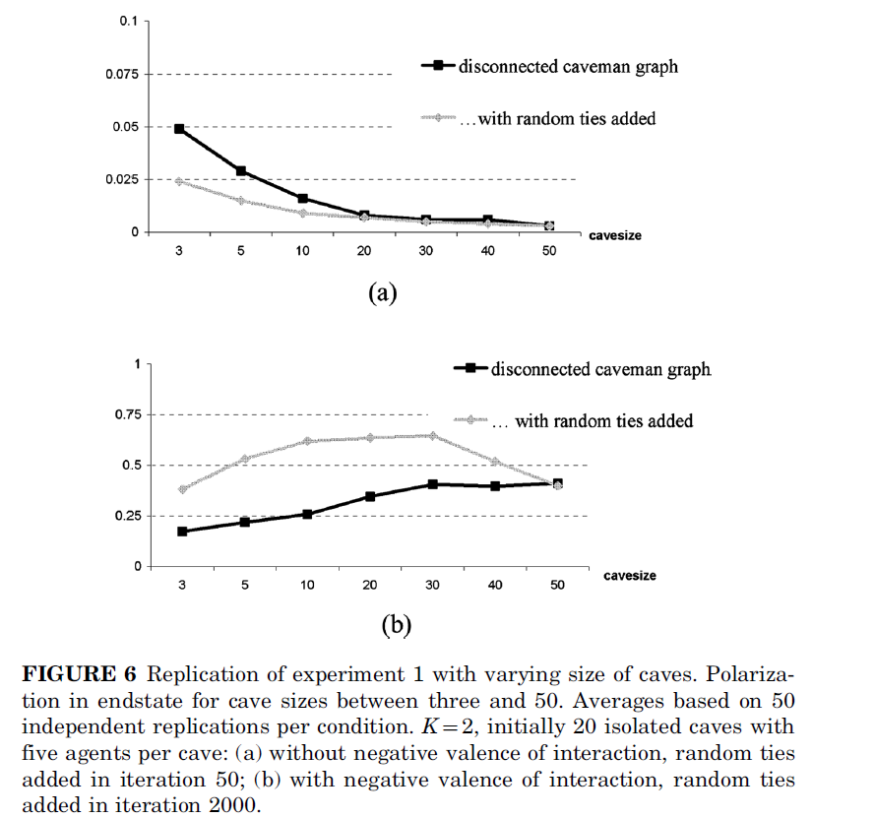

Slide 18
